Slide 1

Introduction to SQL
Presented BY
S.SURYA PRAKASH
Y.V.SURESH

Slide 2

AGENDA
Introduction to SQL
Why we are using SQL
Data Base Connectivity
Creating Data Base
Creating Table
Inserting Data
Prepared Statements
What about the Errors

Slide 3

Introduction to SQL
SQL (Structured Query Language) is a programming language used to manage and manipulate data stored in a relational database management system (RDBMS).
In simpler terms, SQL is used to interact with databases, retrieve and manipulate data, and perform various operations on the data, such as inserting, updating, and deleting records. It provides a standard way to communicate with databases, making it possible for different software applications to work together.

Slide 4

Why we are using SQL?
SQL is also a powerful language that allows for complex queries, joins, and aggregates, making it useful for a wide range of applications, from small businesses to large enterprises.
SQL is Standard language used by many different database systems…
SQL have the ability to manage large amount of data,easy to use,Data security,flexible and adapted and scalability(fixing the number of users)

Slide 5

Database Connectivity
Database Connectivity can be achieved using different methods, such as using programming languages like SQL or connecting through application programming interfaces (APIs). The use of middleware technologies like ODBC and JDBC can also facilitate database connectivity.

Slide 6
Database Connectivity
To connect to a database using SQL, you need to create a connection string that contains the database server name, database name, username, and password.
Here's an example of a connection string in PHP:
$conn = mysqli_connect("localhost", "username", "password", "database_name");
if (!$conn) {
die("Connection failed: " .mysqli_connect_error());
}
else
{
echo “Connection Successful”;
}

Slide 7

Creating Database
To create a database in SQL, you can use the CREATE DATABASE statement. The CREATE DATABASE statement may include additional parameters such as character set and collation. Here's an example of creating a database named "mydatabase":
Syntax:- CREATE DATABASE mydatabase;
Query:- CREATE DATABASE LakhSingh;

Slide 8
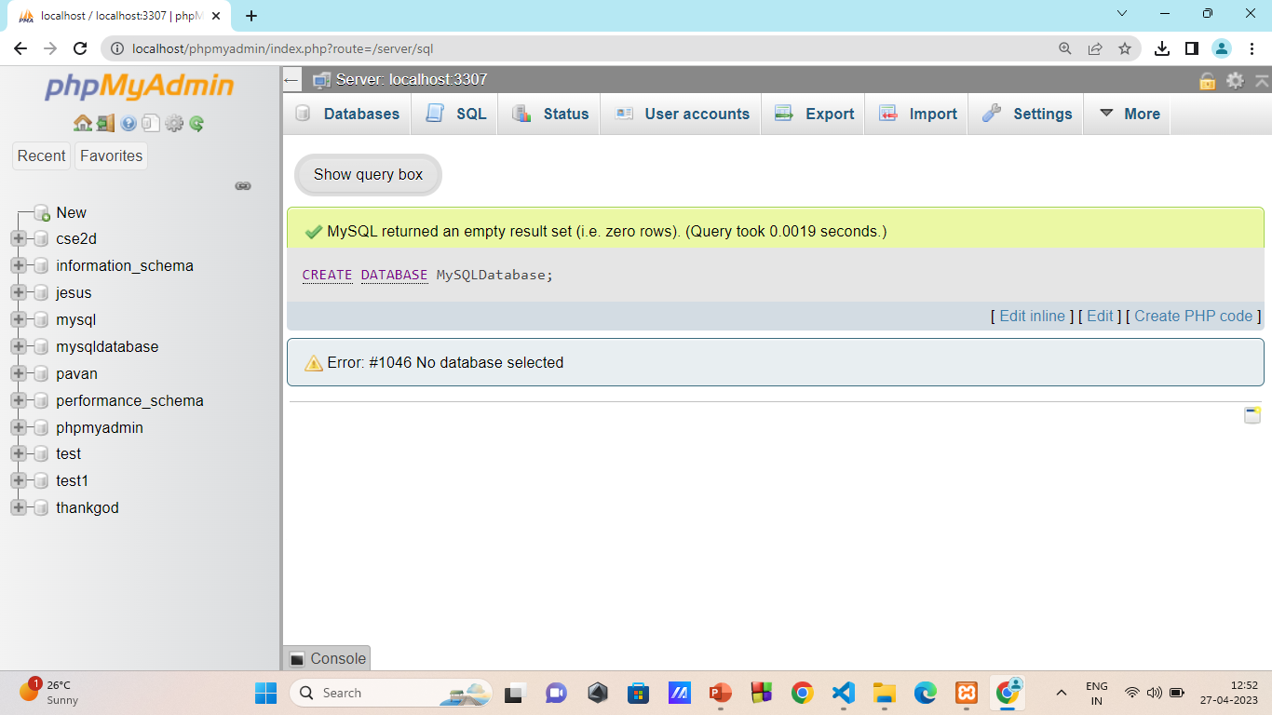
Execution:-

Slide 9


Creating Table
S.No | Student Name | Gender | Age | Ph.no
Not this table
This table

Slide 10

Creating Table
To create a table in SQL, you can use the CREATE TABLE statement. Here's an example of creating a table named “CSE-2D" with columns "id", "name", "email", and "phone":
CREATE TABLE CSE-2D (
id INT(6) UNSIGNED AUTO_INCREMENT PRIMARY KEY,
name VARCHAR(30) NOT NULL,
email VARCHAR(50) NOT NULL,
phone VARCHAR(15) NOT NULL
);

Slide 11
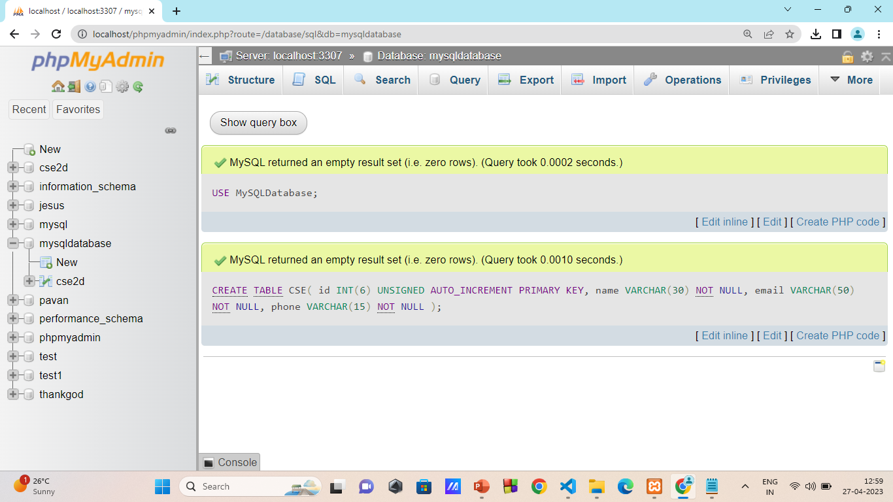
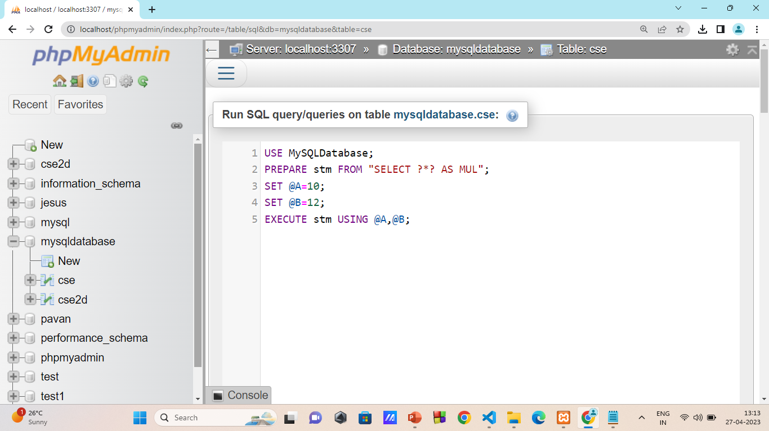
Execution:-

Slide 12

Inserting Data
To insert data into a table in SQL, you can use the INSERT INTO statement. Here's an example of inserting a customer named “CSE-2D" with email “CSE-2D@domain.com" and phone number “1234567890”:
Syntax:- INSERT INTO table_name (column1, column2, column3, ...) VALUES (value1, value2, value3, ...);
Query:- INSERT INTO CSE-2D (name, email, phone)
VALUES (‘CSE-2D’, ‘CSE-2D@domain.com', '123-456-7890’);

Slide 13
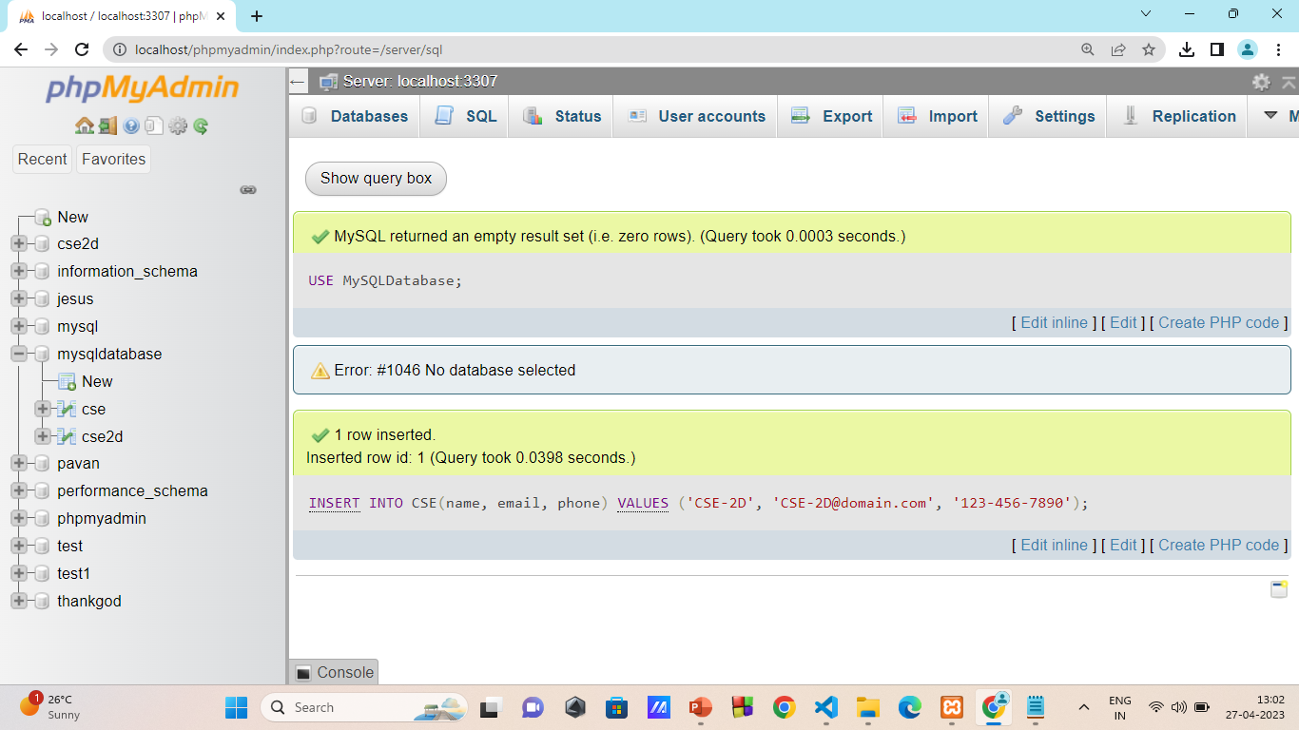
Execution1:-

Slide 14
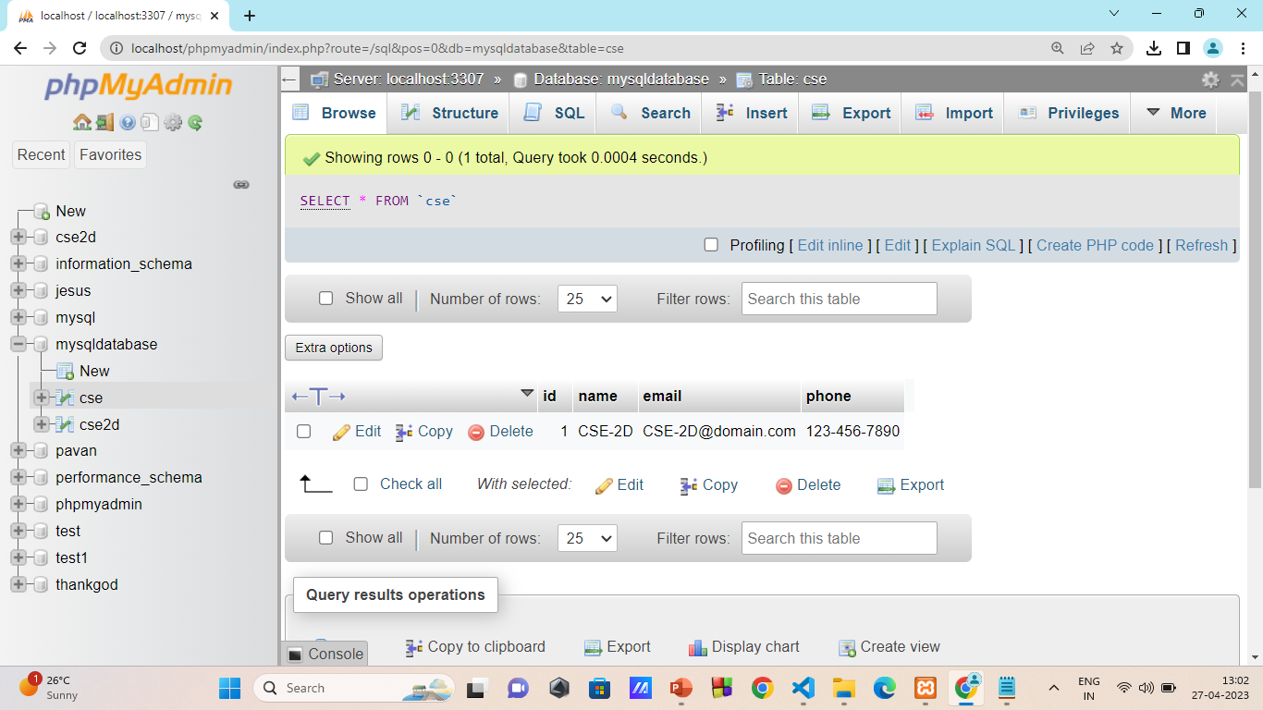
Execution2:-

Slide 15
Prepared Statements
Prepared statements in SQL (Structured Query Language) are a way to execute a query more efficiently and securely.
In before of the MySQL version 4.1,before returning the result to the client, MySQL has fully parse the Query and converts the result into the String
Our Prepared Statement was introduced in MySQL version 4.1.
The main use of the prepared statements is to execute the same statement repeatedly with high efficiency
Prepared statements that contain a placeholder(?)
SELECT * FROM student WHERE id=?;

Slide 16
Basic Work Flow
The basic work flow of the prepared statement mainly consists of two stages.
A.PREPARE:- At the prepare stage, a statement template is sent to the database server.
In shortly, it prepares a statement for execution
PREPARE statement_name FROM “ Prepared_statement”;
B.EXECUTE Stage:- In this stage, the client blinds parameter values and send them to the server.It will executes the query which already prepared by using PREPARE Statement
EXECUTE statement_name USING var1,var2

Slide 17
Basic Work Flow
C. DEALLOCATE/DROP Stage
It is the last and optional stage, which is used to release the prepared statement.
After droping the prepare statement, we cannot use it any more
DEALLOCATE PREPARE statement_name;

Slide 18
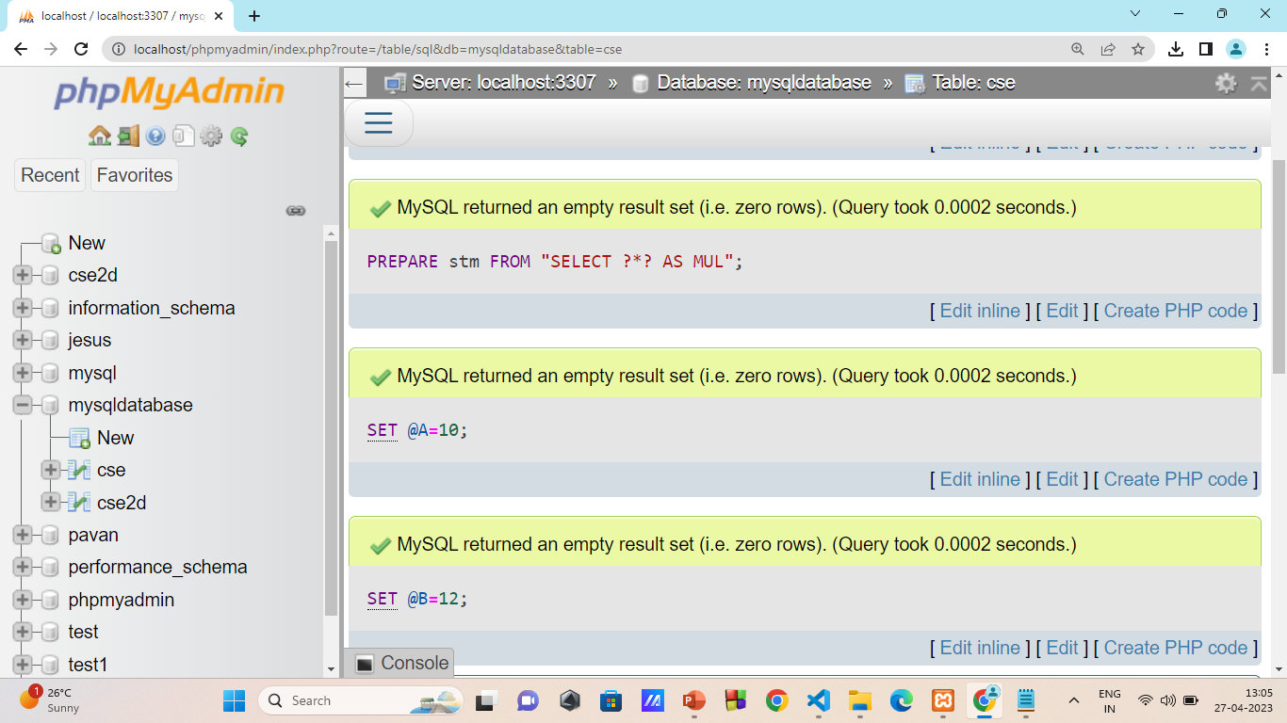
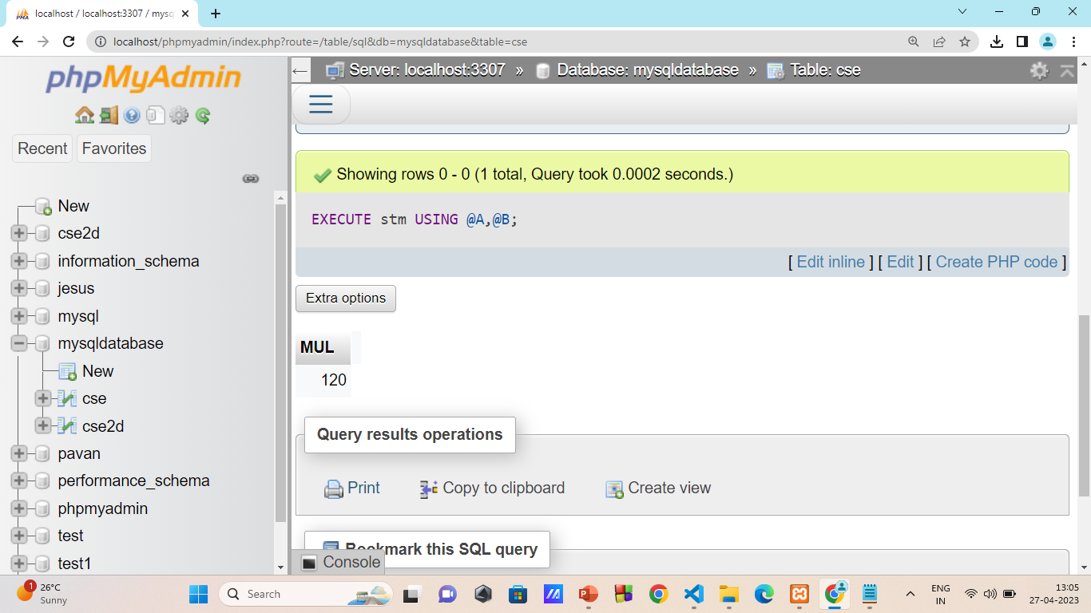
Execution:-

Slide 19
Key Points in Prepared Statements:-
Prepare Statements created in one session are not available for other sessions. When a session ends, whether normally or abnormally, its prepared statements are no longer exists in the memory.
Statement | Prepared Statement
It is used when we want to execute the SQL query only once | It is used when we want to execute the SQL query multiple times
It is static, which means we cant pass parameters at runtime | It is dynamic,which means we can pass the parameters at runtime
The performace execution is slow | The performance execution is fast
It doesnot prevent SQL Injection | It helps to prevent SQL Injection

Slide 20


What about the Errors?

Slide 21


My feelings after facing errors

Slide 22

Thank You

Slide 23



Slide 24

My Special Thanks to:-
Lakshmi Sree Mam,
Assist.Proffessor

